Slide 1

Postural Care Equipment Waiver Form

Slide 2
How to use this form
Create a copy before editing.
This form is for recording the final outcome of your discussion about postural care with service users who have capacity but require communication support. It states what was understood and agreed
It states the main points a service user must understand if refusing to use any of the postural aids prescribed for them
Use/print off only the pages that are relevant for your service user (e.g. section on foot support if they only want to use foot straps during transport )
Also use/print off page 20 detailing the agreement either to not use the equipment at all, or only during certain periods or activities
Copy & paste an image of the equipment in question onto that page
You can print off a copy for the service user's own records

Slide 3
What this form was not designed for
Gaining consent to use existing equipment as prescribed. Consent is assumed as having been gained by the equipment prescriber at the point of prescription. However, you are welcome to use this powerpoint to create a consent form if you are a prescriber of postural care equipment and interventions.
Education about postural care. To educate, use the Postural Care Communication Resource. This contains individual symbols to support conversations about posture as well as readymade posters for the following messages:
  Good posture helps you with…
  Bad posture causes problems with….
  (Equipment that) helps with good sitting posture
  No (equipment) help with lying causes problems with…
  (Equipment that) helps with good lying posture
  (Equipment that) helps with walking and standing
  Standing is good for…….

Slide 4

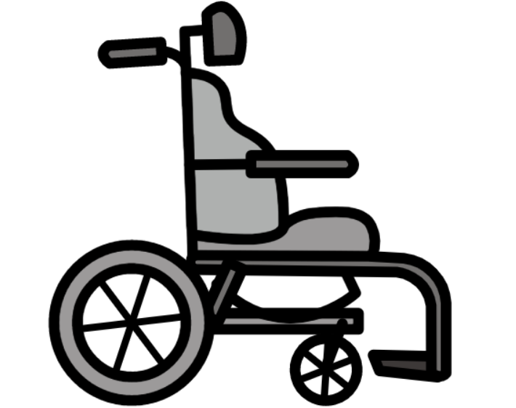
Equipment for sitting

Slide 5




Headrest

Slide 6
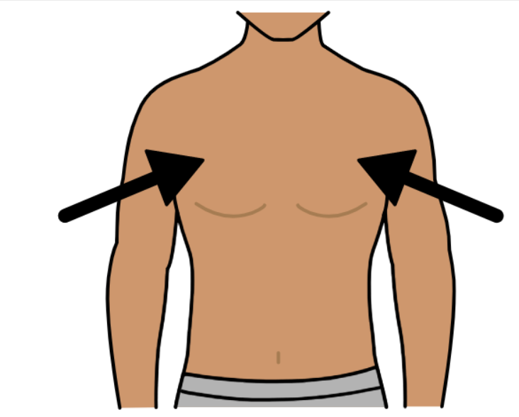

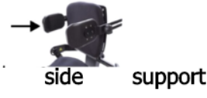
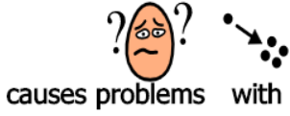


Upper Body support

Slide 7
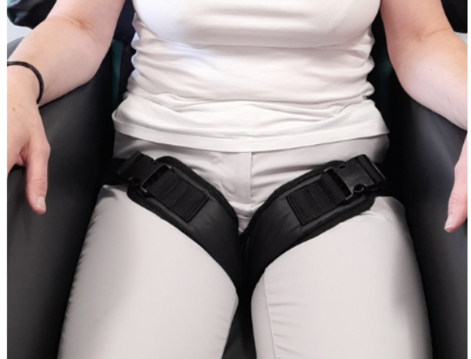
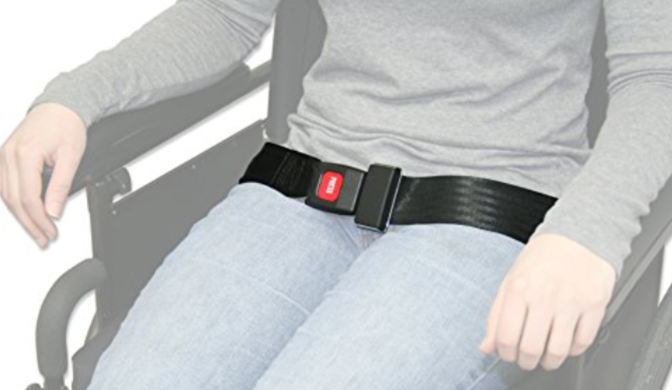



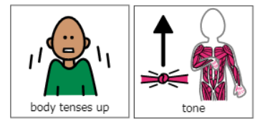

Seatbelts

Slide 8




Pommel

Slide 9
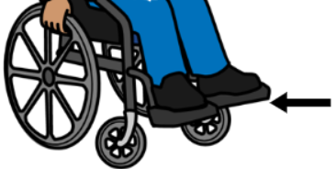





Foot Support

Slide 10


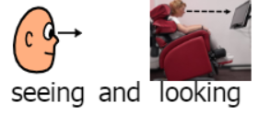


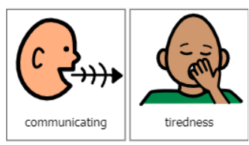
Tilt in Space

Slide 11
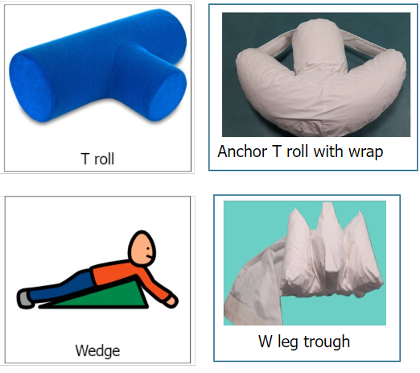

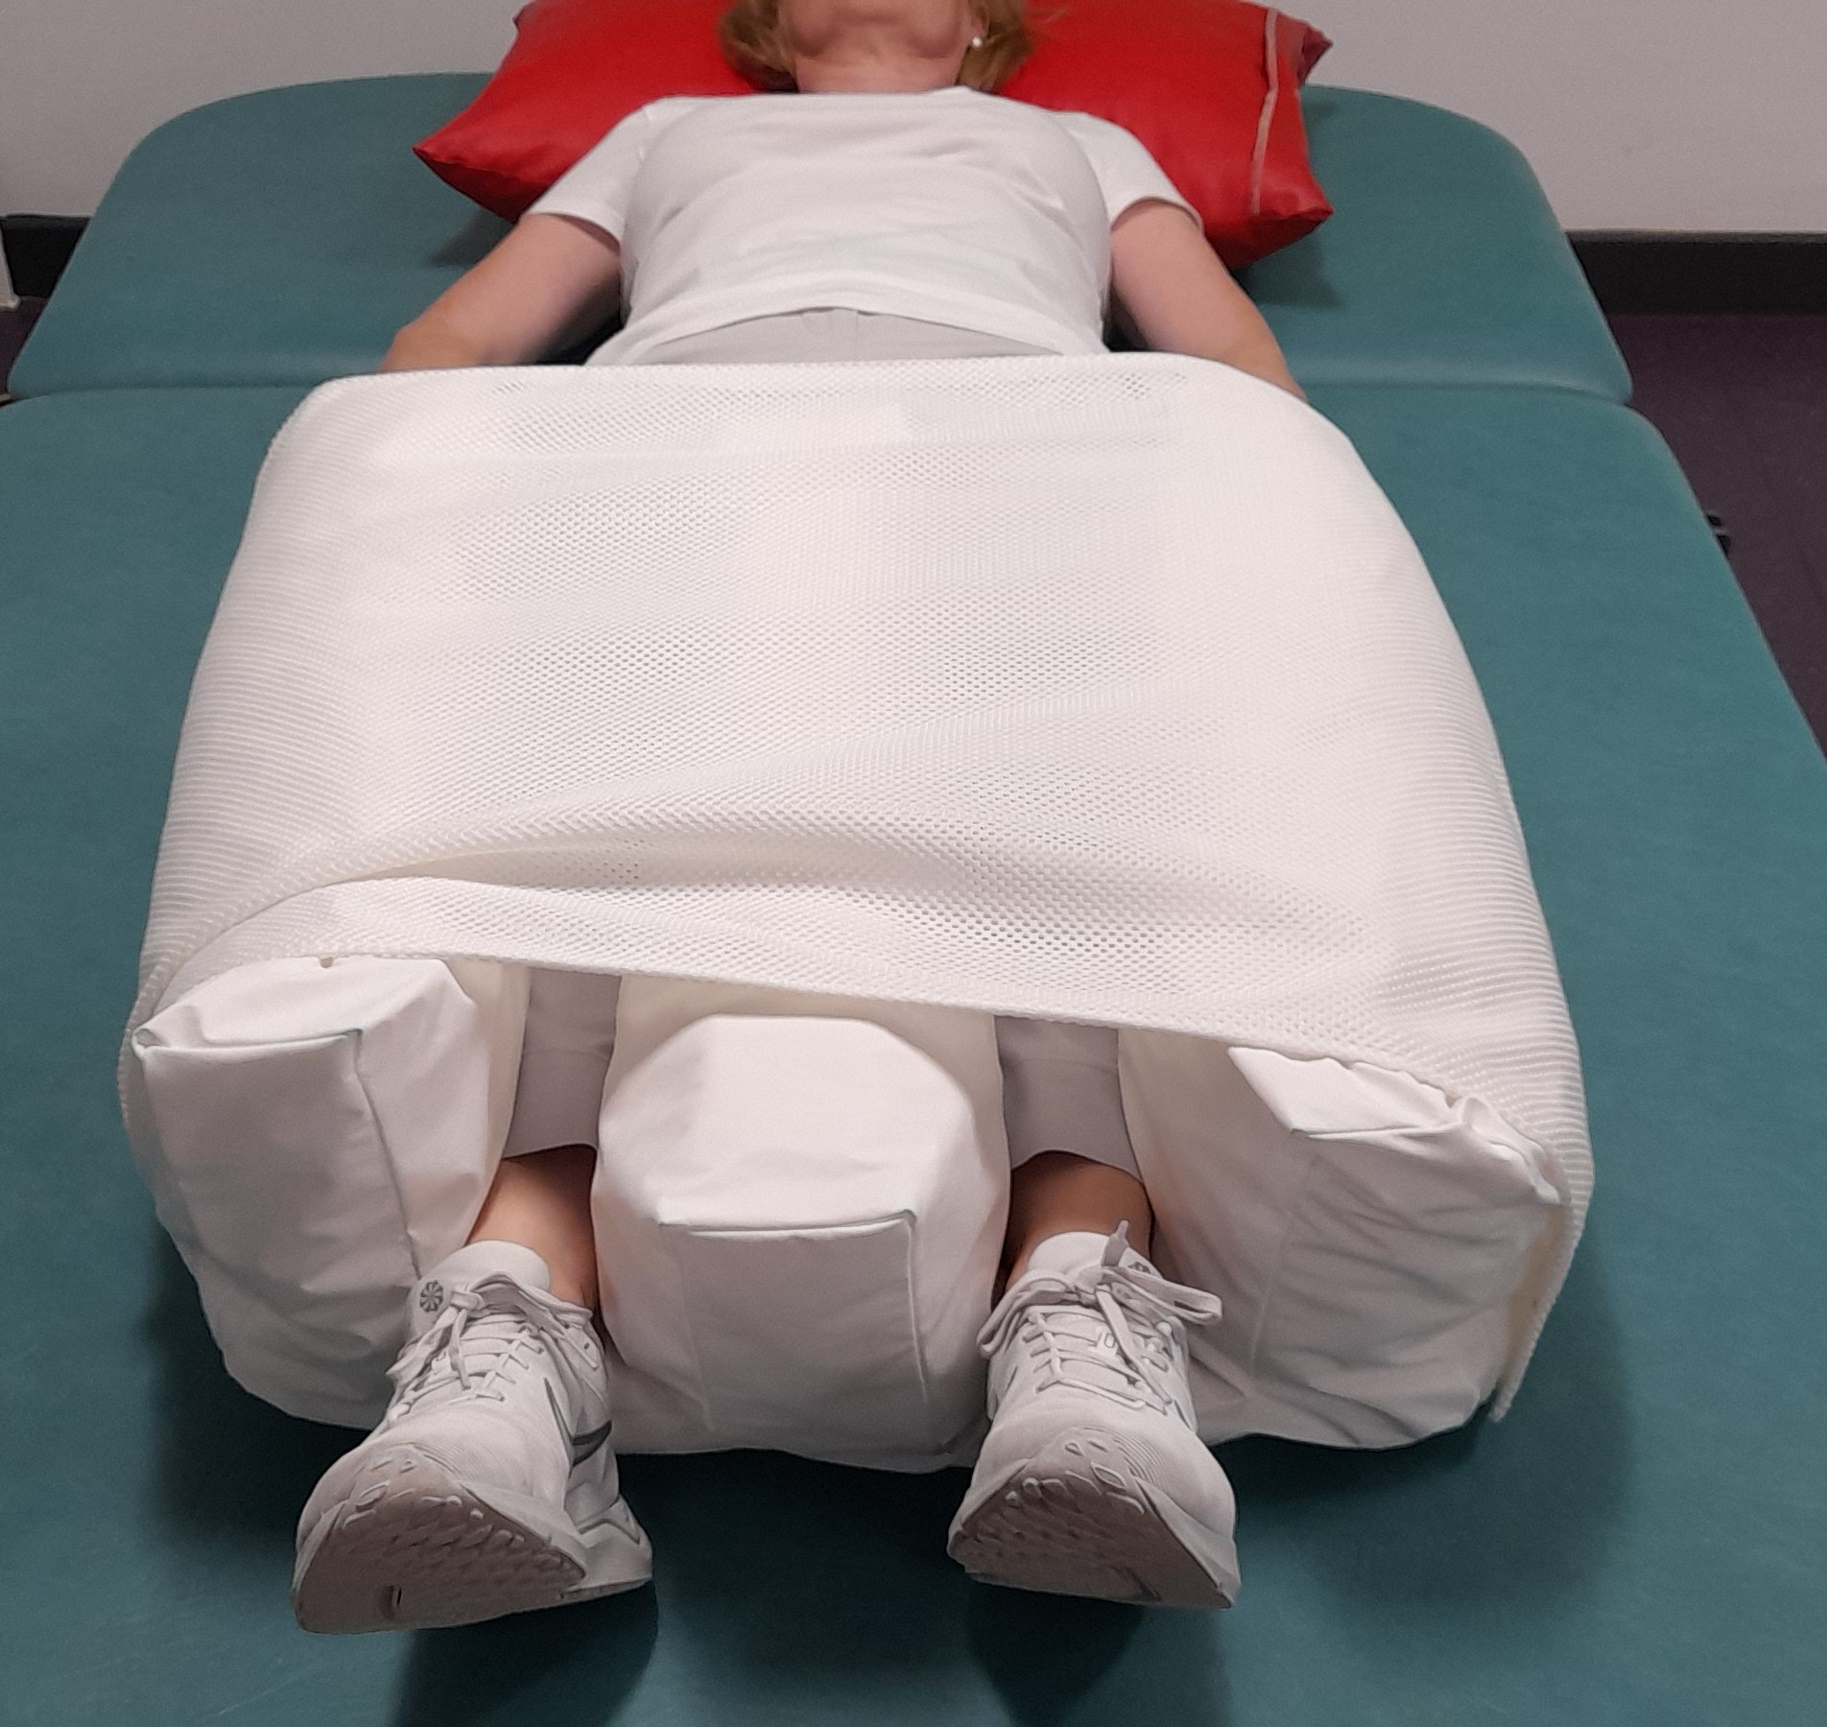
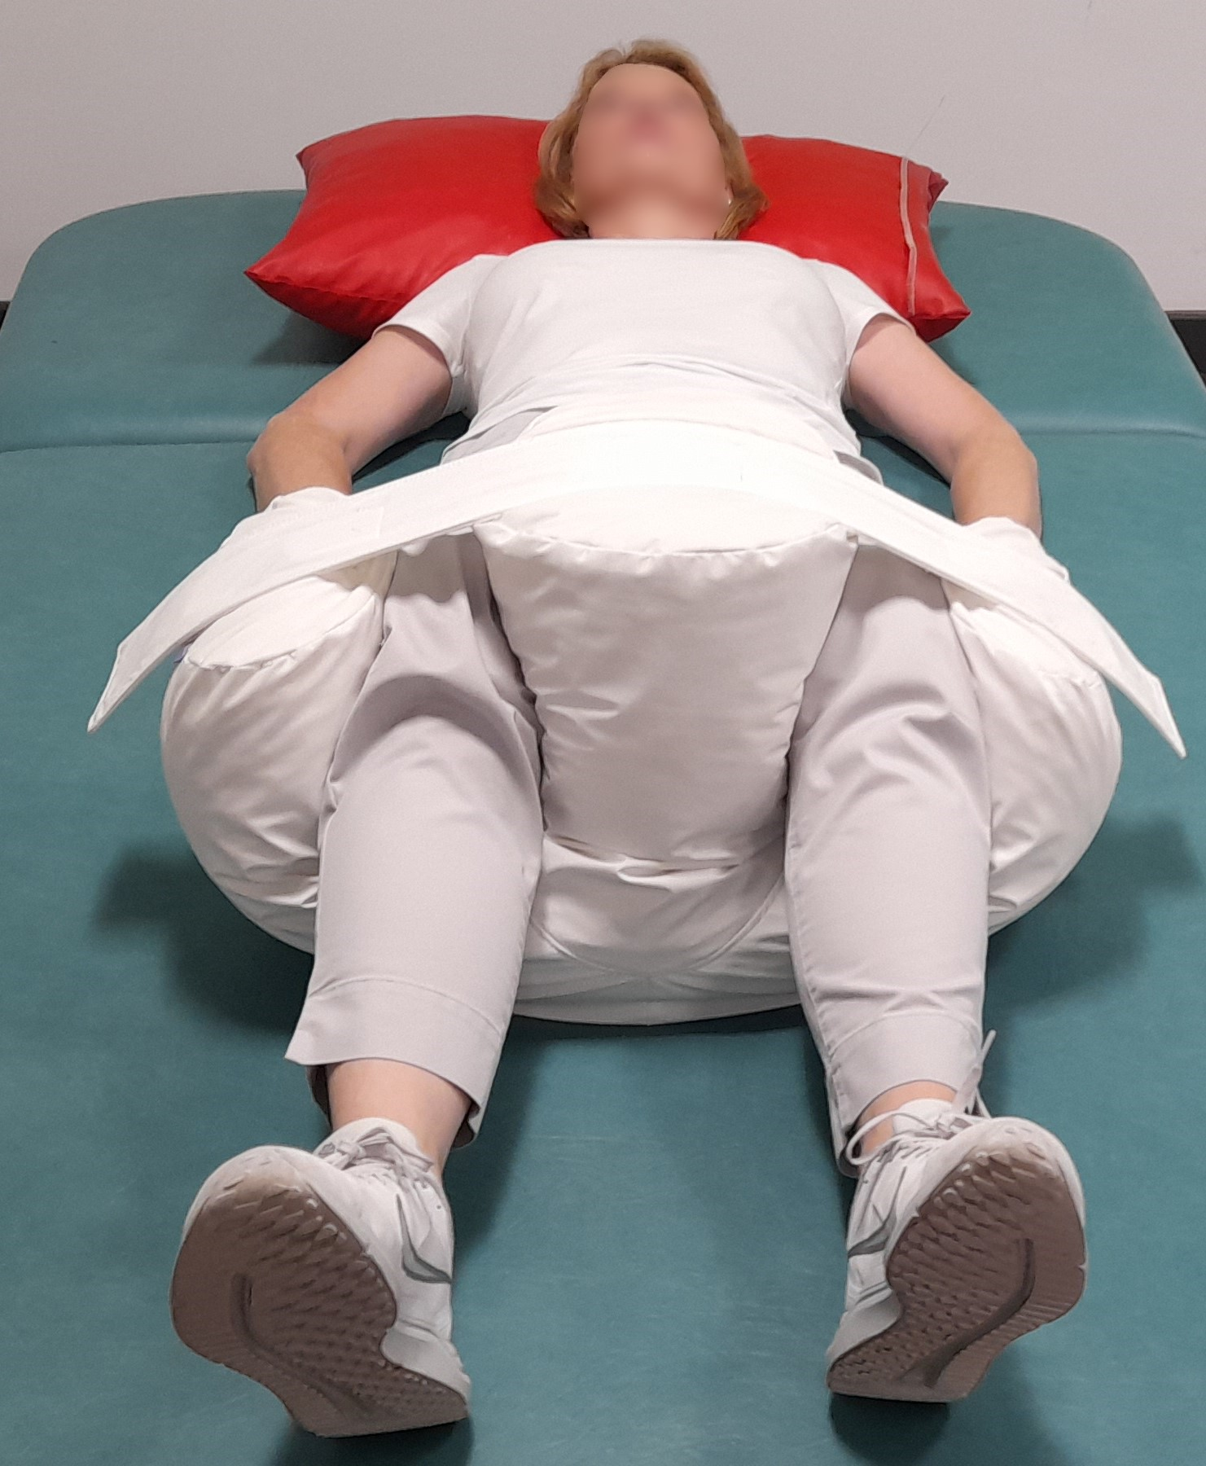
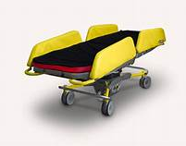
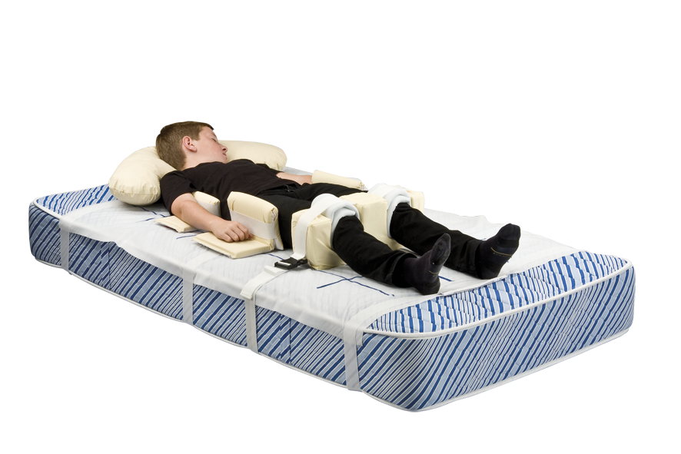
Equipment for lying

Slide 12





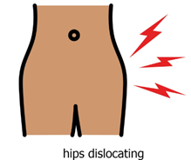
Equipment for lying

Slide 13
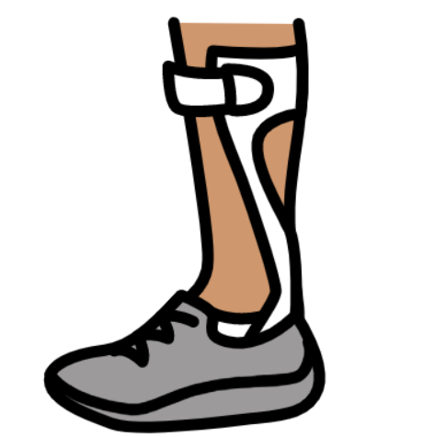
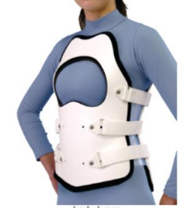

Splints and braces

Slide 14

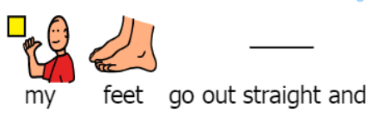
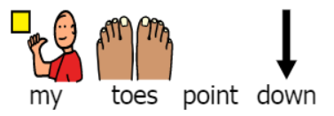


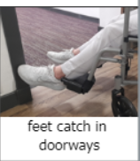
Footsplints

Slide 15






Hand splints

Slide 16

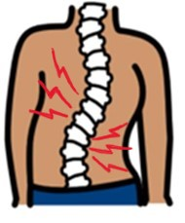

Body brace

Slide 17
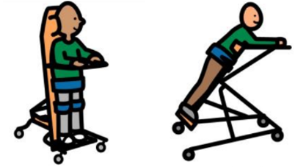



Standing equipment

Slide 18




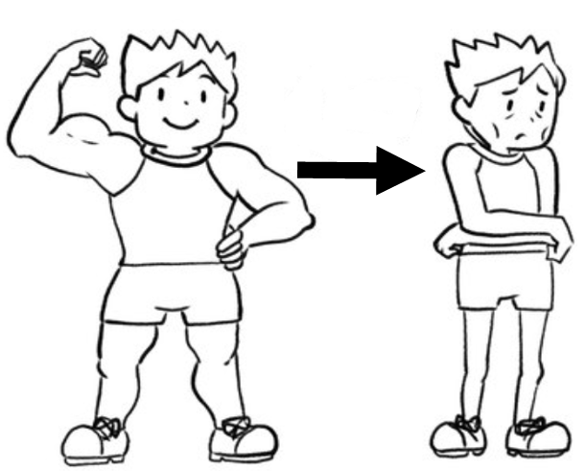
Exercises/stretches

Slide 19

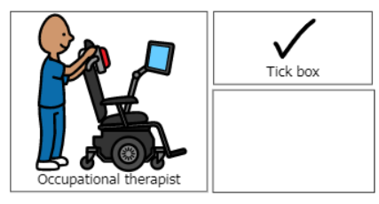
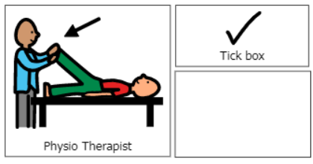

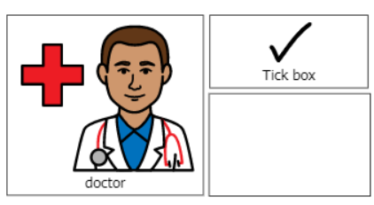
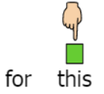
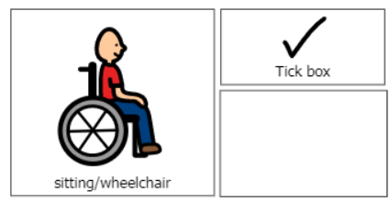
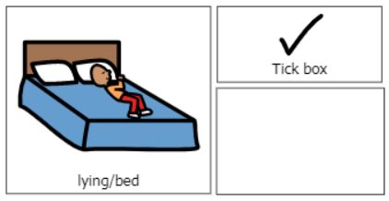
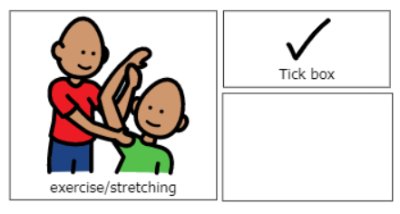
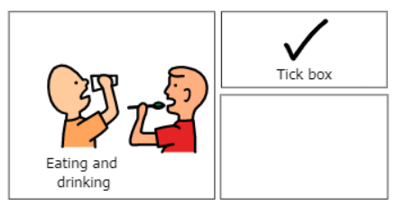
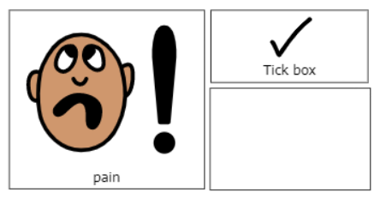
Referral for review
…………………….

Slide 20

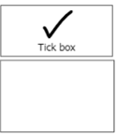


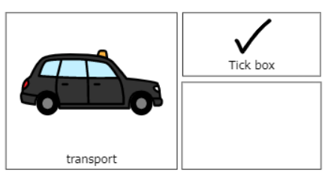
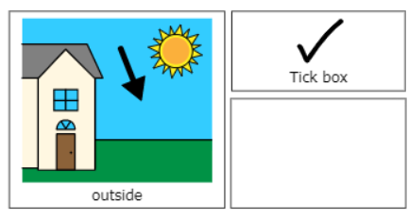
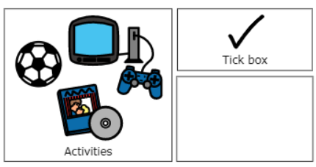
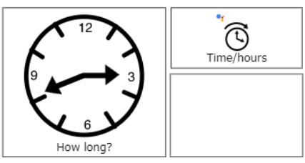

Slide 21
